Slide 1

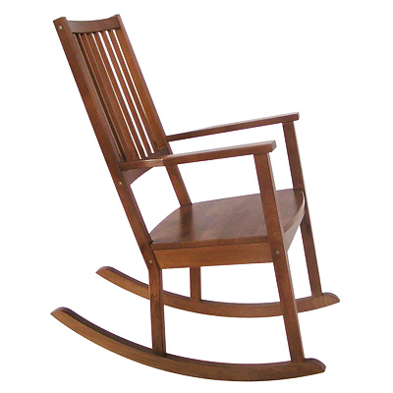
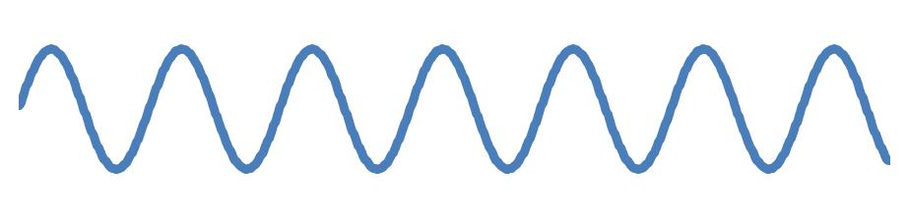
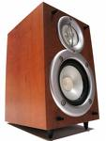
Differences between Spontaneous and Intentional Entrainment to a Musical Beat
Alexander P. Demos, Roger Chaffin, & Kerry L. Marsh
Department of Psychology, University of Connecticut
Introduction
Data Analysis
Results & Discussion
Listeners often move spontaneously when listening to music (Clayton, 2007).
Entrainment to rhythmic stimuli (music or metronome) has been extensively studied in tapping tasks (Repp, 2005).
People tend to tap to a musical beat in simple ratios (1:1 or 2:1) but can show less stable complex ratios (3:2; Large, 2008).
Tapping studies require intentional movement.
Spontaneous movement cannot be readily studied.
Spontaneous intermittent entrainment to a distractor beat can occur during intentional tapping to a target beat (Repp, 2006).
Spontaneous intermittent entrainment (i.e., synchrony) can be observed when people rock side by side with another person in rocking chairs (Richardson et al., 2007).
We compared spontaneous and intentional entrainment of rocking with a musical beat.
Did rockers synchronize their movements to the musical beat?
Spontaneous condition
Intentional Condition
Dependent Variable:
Sync Ratio = IRI / IBI
Calculated for each of 11 trials
Expect Simple Ratios:
“1” = 1:1 = moving with the beat of music
“2” = 2:1 = moving 2x as fast as the music
Predictions:
Constant ratio as tempo ↑ = sync with music
↓ ratio as tempo ↑ = not sync with music
Sync ratios generally ↓ as tempo ↑
Overall, participants did not synchronize with the music.
Entrainment to simple ratios less than expected by chance, χ² (1, N = 286) = 7.36, p < .01.
Participants did NOT sync with music in simple ratios. Instead, AVOIDED simple ratios with music.
Sync ratios for several participants were constant at simple ratios across trials .
Others showed simple ratios for some trials.
Entrained to simple ratios more than expected by chance, χ² (1, N = 396) = 4.19, p < .05
Participants did sync with music.
Legend for bar charts
First bar = 60 bpm & last bar = 80 bpm
all other bars +2 bpm from first bar
Method
Did music affect rocking speed?
Both conditions were significantly different from 0.
Spontaneous:
t(13) = 2.84, p < .05
Intentional:
t(18) = 3.28, p < .01
Intentional > Spontaneous :
t(29) = -2.09, p < .05
Conclusions
Participants
31 participants at the University of Connecticut
Cover Story
Interaction of memory and movement
Materials
Wooden rocking chair three feet in front of a projection screen.
Magnetic motion tracking system at 60 Hz (Polhemus Fastrak)
Procedure
12 trials of rocking for 45 secs, all included a memory task.
1 baseline trial at start
11 music trials with a steady drum beat in the background at different tempi (60 to 80 bpm)
Tempo changed between trials by 2 bpm, either ↑ ↓ or random
Memory task: 5 words to recall after rocking.
Instructions for music trials
Rock at a comfortable pace (Spontaneous condition; N = 13)
Rock with the music (Intentional condition; N = 18)
Baseline trial IRI = participant’s natural frequency.
Baseline Ratio = IRI / IBI (all 11 tempi)
11 baseline ratios for each participant
Baseline ratio = hypothetical scenario of being unaffected by the music.
Intentional vs spontaneous instructions → different types of entrainment:
Intentional → “Move with the music”:
Synchronized with the beat
Rocked faster than expected (based on baseline trial)
Spontaneous → “Move at a comfortable pace”:
Little synchrony with the beat across trials
But, intermittent entrainment with beat within trials
Changed their pace because of the music
Rocked faster than expected (based on baseline trial)
Effects occurred in spite of distracter task
Dependent Variable:
Sync Ratio - Baseline Ratio
+ Values = rocking faster than expected baseline
- Values = rocking slower than expected baseline
Participants in both groups rocked faster than expected from their baseline rate of rocking.
Did rockers intermittently coordinate their movements with the musical beat?
Spontaneous condition
e.g., Participant 3, Trial 2 (62 bpm)
Intentional condition
e.g., Participant 13, Trial 1 (60 bpm)
Acknowledgements & References
Musical beats transformed into a sin wave
Hilbert transformation to get phase angle (out of 360˚):
a) Movement of the chair
b) Music sin wave (simple ratios only)
Took instantaneous relative phase between phase of movement and music:
φ(t) = θ_{movement}(t) – θ_{music}(t)
Rose diagrams show frequency of relative phases (φ) for one trial.
Rayleigh's test for non-uniformity (Fisher, 1993), p < .001, tested for intermittent entrainment (i.e., syncing for part of the trial).
Example of intermittent sync with music
Example of stable sync with music
Bruce Kay and Mike Richardson for use of their Matlab scripts. Alexander Stackpole and Jared Marinuzzi for running the participants.
Clayton, M. (2007). Observing entrainment in music performance: video-based observational analysis of Indian musicians’ tanpura playing and beat marking. Musicae Scientiae, 11, 27-60.
Fisher, NI. (1993) Statistical Analysis of Circular Data, Cambridge University Press.
Large, E. W. (2008). Resonating to musical rhythm: Theory and experiment. In Simon Grondin, (Ed.) The Psychology of Time. West Yorkshire: Emerald.
Repp, B. H. (2005). Sensorimotor synchronization: A review of the tapping literature. Psychonomic Bulletin & Review, 12, 969–992.
Repp, B. H. (2006). Does an auditory distractor sequence affect self-paced tapping? Acta Psychologica, 121, 81–107.
Richardson, M.J., Marsh, K.L., Isenhower, R.W., Goodman, J.R.L., & Schmidt, R.C. (2007). Rocking together: Dynamics of intentional and unintentional interpersonal coordination Human Movement Science, 26(6), 867-891.
Data Preparation
Rocking Movement Data
Musical Beat Stimulus
Rocking chair time series of motion
Beats of the music
Forward
Spontaneous:
61% of trials showed relative or stable synchrony with the music.
χ² (1, N = 143) = 6.72, p < .05
Intentional:
71% of trials showed relative or stable synchrony with the music.
χ² (1, N = 198) = 37.35, p < .001
Backward
Inter-Response Interval (IRI)
Inter-Beat Interval (IBI)

